Slide 1
Jingdong: High Potential Users’ Intention to Buy Products
Group2 SVM
Kaichneg Wang
Sshengfei Yu
Xin Xu
Jiuru Shao

Slide 2
Contents
Introduction
Problem Definition
Data Analysis
Experiments and Results
Evaluation
Conclusion

Slide 3
Introduction
Jingdong provides the sales data of merchandises of various types, together with the user’s action data, and it aims to predict if a given user will make purchase on an item of category 8 in the next five days.

Slide 4
Dataset

Slide 5
Problem Definition
What type of problem is it?
Prediction? Classification?
Idea
To extract features from the previous days before purchase happens
Cluster users and items into groups
Sample both positive and negative features for training
Predict whether users will buy products and what they will buy in the last five days

Slide 6
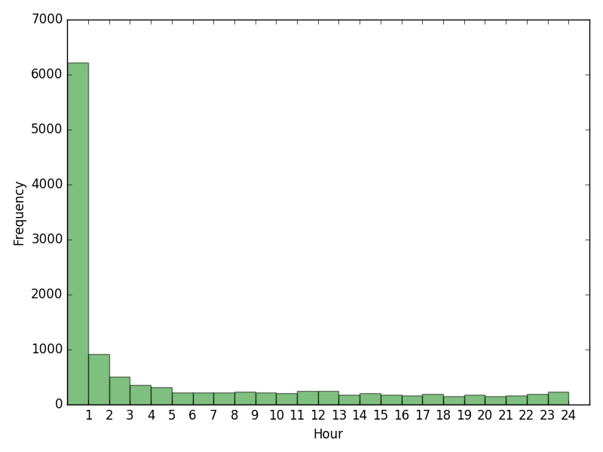
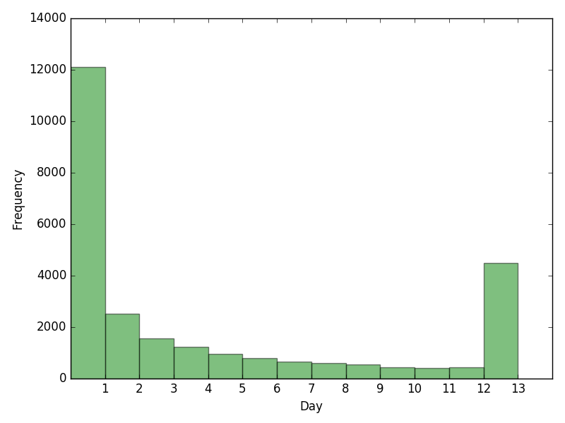
Data Analysis
The duration between the first action and the purchase - User

Slide 7
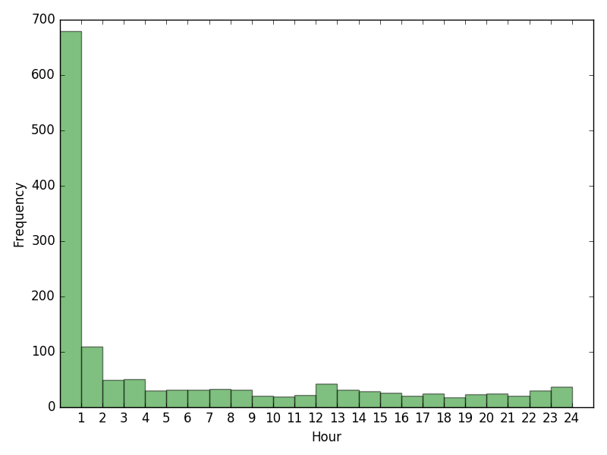
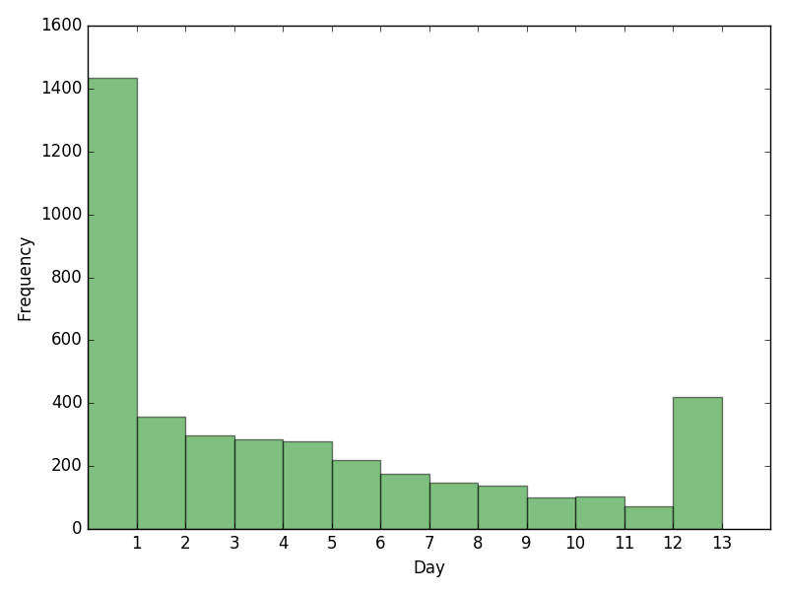
Data Analysis
The duration between the first action and the purchase - Item

Slide 8
Data Analysis

Slide 10
Experiments and Results
Features:
User actions:
Pageviews
number of adding products to cart
number of deleting products from cart
number of purchases
number of liking products
number of clicks
User category
Product category

Slide 11
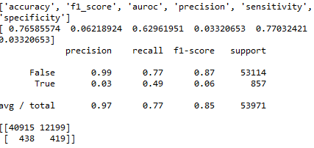
Evaluation
Official evaluation:
F11 = 6*Recall*Precision/(5*Recall+Precision),
F12 = 5*Recall*Precision/(2*Recall+3*Precision)
Score = 0.4*F11 + 0.6*F12
0.00047514517565

Slide 12
Conclusion

